Slide 1
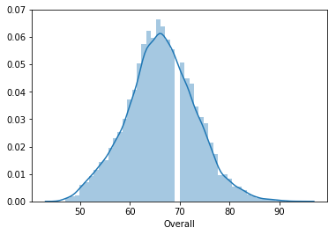
EDA MINI Project Highlights
Distribution plot of Overall rating for all players shows that Data is close to Bell-shaped curve and data seems normally distributed.

Slide 2
There is a good correlation between the Overall Rating of a player and his Value. Correlation was found out to be 0.68 which indicates quite a good correlation
Facts about top 20 players ranked by Overall score and whose contract expires in 2020.
Their Average Wage is : 220100.0
Average age of these players is: 30.45

Slide 3
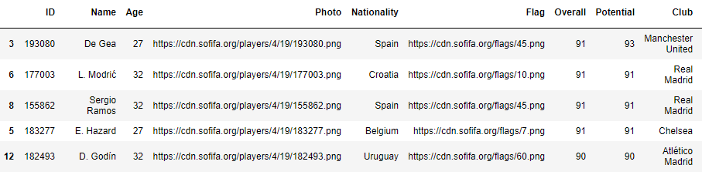
Snippet of top five from the top 20 players details

Slide 4
Fifa dataset consist of players playing in 27 unique positions like ST, GK, CB, CM etc
Among the top five players in all position, players playing for ST position has highest average salary of 294000
Among the top five players in all position, players playing for LWB position has least average salary of 34200
Top five playing in a unique positions have no duplicate names.

Slide 5
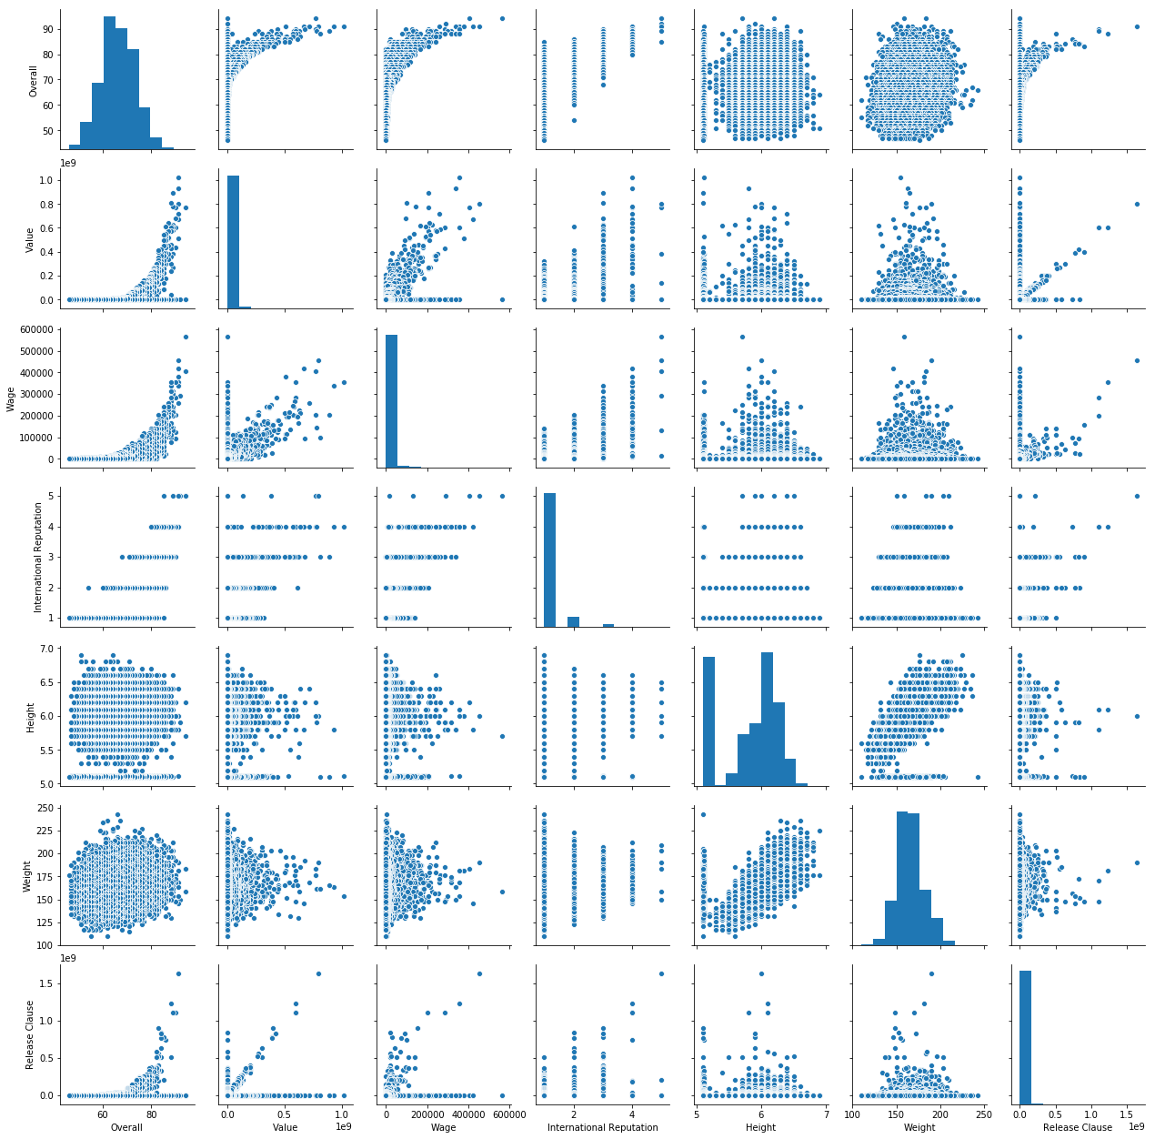
Pair plots for the following variables: Overall, Value, Wage, International Reputation, Height, Weight, Release Clause

